Slide 1
Programming in Modern Fortran
Fortran 2003/2008

Slide 2
Compilers versus Interpreters
A compiler produces a stand-alone binary for a given platform (cpu+operating system). The output of a compiler is an object file, represented with a .o suffix on Unix.
A linker takes the .o files and any external libraries and links them into the executable. Normally the linker is invoked through the compiler.
An interpreter interprets line by line. The binary that is run is the interpreter itself. Programs for interpreters are often called scripts. Scripts are frequently cross platform, but the interpreter itself must be appropriate to the platform.

Slide 3
Compiled Languages
Compiled languages are:
Generally stricter about typing (static typing) and memory allocation.
Generally produce faster and more efficient runs.
Interpreted languages are:
Generally looser about typing (dynamic typing).
Generally have dynamically sized data structures built in.
Often run very slowly.

Slide 4
Why Fortran
Fortran is still very widely used in many environmental sciences, particularly atmospheric sciences and oceanography.
Features of modern Fortran make it very well suited to numerically-intensive programming.
Many scientific programmers have to know both C/C++ and Fortran

Slide 5
Why Does Fortran Have a Reputation?
As the oldest higher-level language, many old code using obsolete constructs still exists and is in use.
Computers for which the first languages were written were extremely limited in memory, speed, and disk space.
Typical memory in the 1960s was measured in kilobytes
A supercomputer circa 1994 had 2GB of RAM

Slide 6
Algol 60
Of similar age and similar design
Sample code (from Wikipedia)
procedure Absmax(a) Size:(n, m) Result:(y) Subscripts:(i, k);
value n, m; array a; integer n, m, i, k; real y;
comment The absolute greatest element of the matrix a, of size n by m, is transferred to y, and the subscripts of this element to i and k;
begin integer p, q;
y := 0; i := k := 1;
for p := 1 step 1 until n do
for q := 1 step 1 until m do
if abs(a[p, q]) > y then begin
y := abs(a[p, q]); i := p; k := q
end
end Absmax

Slide 7
Newer Fortran
The language has changed dramatically since 1957 but the name has never changed.
Algol's descendants include Pascal and C (but note how different C is)

Slide 8
Strengths and Weaknesses
C++ (not C)
Fortran
Limited mathematical built-ins
True multidimensional arrays not possible without add-on libraries (Blitz++, Boost)
Pretty good string handling (compared to C)
Straightforward implementation of classes (but no modules)
(2003/8) Many math function built-ins
Multidimensional arrays a first-class data structure, array operations supported
Does not support true strings yet, just character arrays
Classes somewhat clunky. Modules fill much of this role.

Slide 9
Quote from Approximately 1985
I do not know what the scientific programming language of the year 2000 will look like but it will be called Fortran.
Apocryphal, sometimes attributed to John Backus (inventor of Fortran) or Seymour Cray (inventor of the supercomputer).

Slide 10
Setting Up Your Environment

Slide 11
Integrated Development Environments
An Integrated Development Environment (IDE) combines an editor and a way to compile and run programs in the environment.
A well-known IDE for Microsoft Windows is VisualStudio. Available through Microsoft Store, not free for individuals.
Mac OSX uses Xcode as its native IDE. Xcode includes some compilers, particularly for Swift, but it can manage several other languages. Available at App Store, free.
A full-featured cross-platform IDE is Eclipse (www.eclipse.org). Free.
A lighter-weight IDE for Windows and Linux is Code::Blocks (www.codeblocks.org). Free.
We will use a very lightweight IDE called Geany since it is free, easy to install and use, and works on all three platforms.

Slide 12
Linux
For users of the University of Virginia's cluster, first load a compiler module.
module load gcc
brings a newer gcc, g++, and gfortran into the current environment
module load geany
geany &
Geany is also available for all popular Linux distributions and can be installed through the distribution's package manager.

Slide 13
Windows and Mac
Geany can be installed on Windows and Mac through the usual software installation methods.
Geany does not install a compiler suite. This must be performed independently.
Macs with Xcode include gcc and g++ but not gfortran.
Windows does not include a default compiler suite, but VisualStudio includes Microsoft C and C++.
Geany can be downloaded for Mac or Windows starting from its home page
www.geany.org

Slide 14
Installing Compilers on Macs
Install Xcode from the App Store.
If you are going to use Fortran, download a binary for your version of OSX from
https://gcc.gnu.org/wiki/GFortranBinaries

Slide 15
Installing Compilers on Windows
MinGW provides a free distribution of gcc/g++/gfortran
Executables produced by the standard MinGW package will be 32 bits
Also install MSYS for a minimalist Unix system.
Download from www.mingw.org
Run installer
Choose packages to install, then click Apply.
After the installation, follow instructions for "After Installing" at http://www.mingw.org/wiki/Getting_Started
Be sure to modify your path environment variable

Slide 16
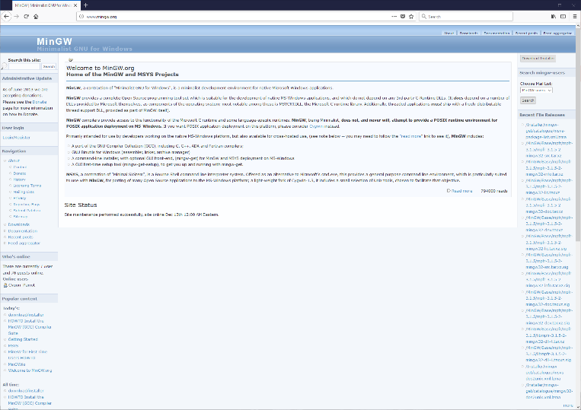
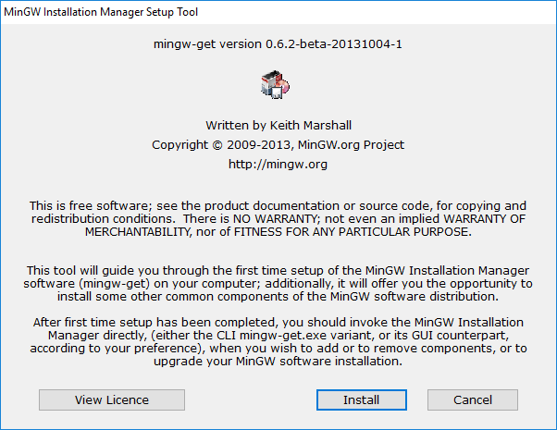
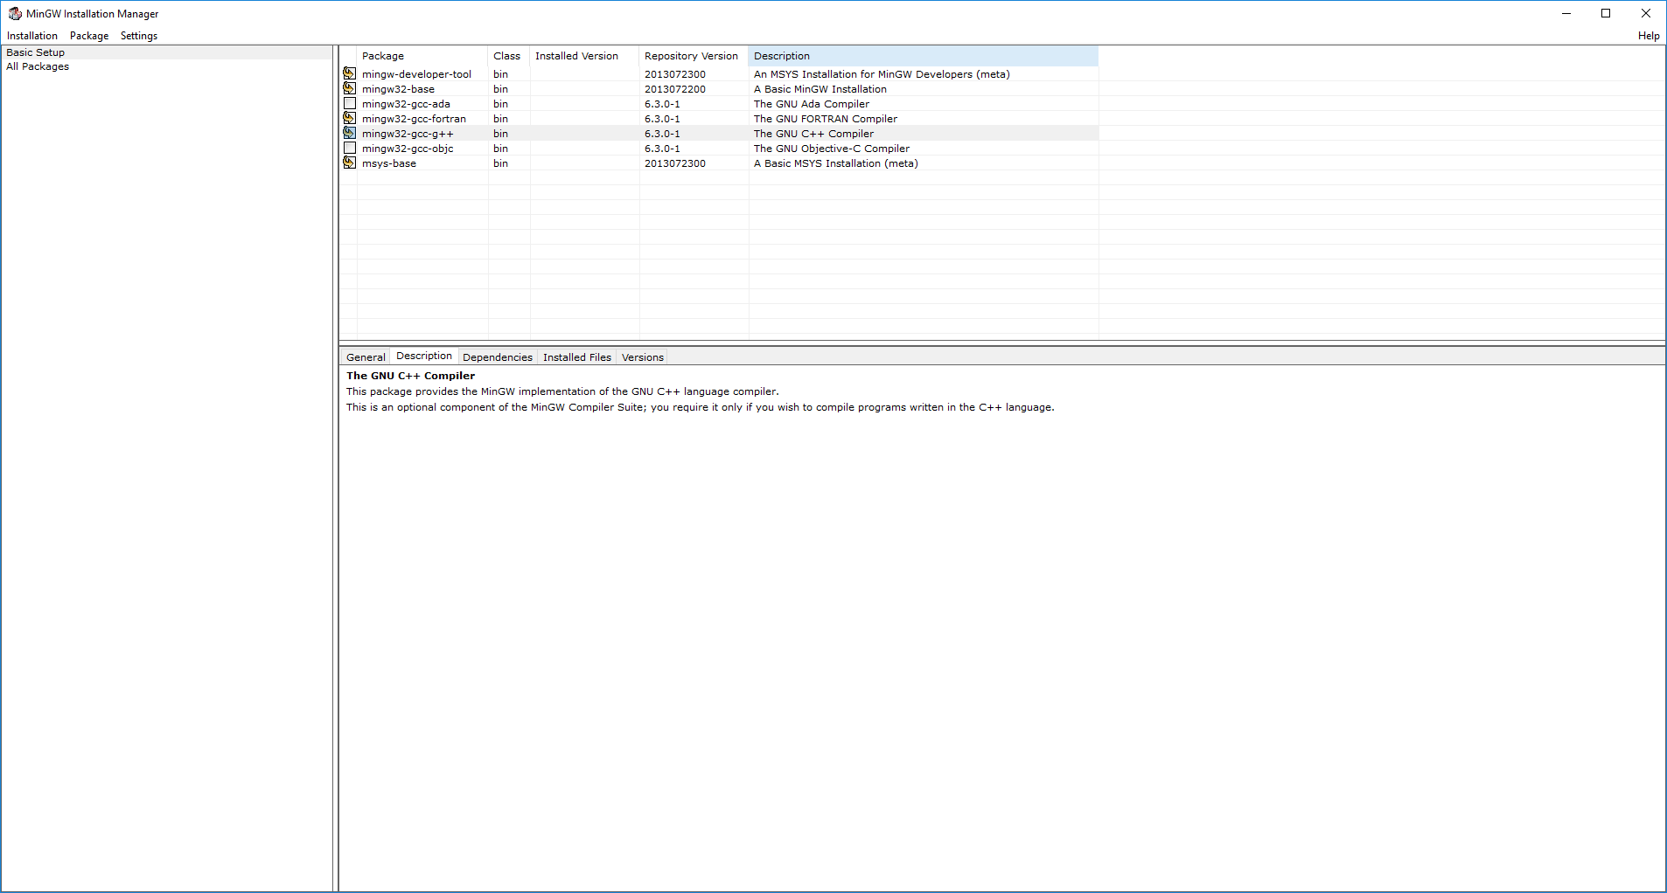
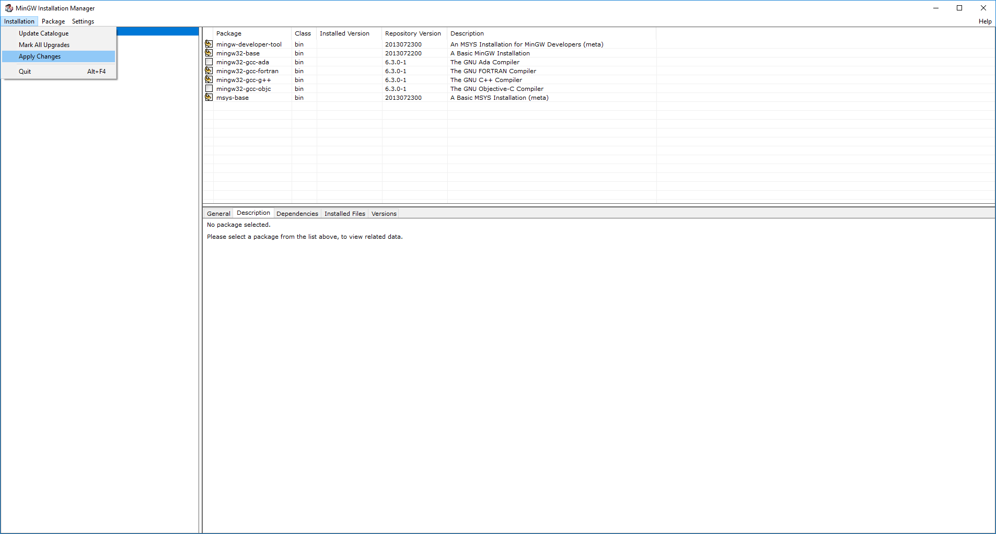
MinGW

Slide 17
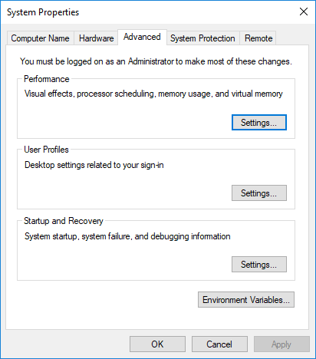
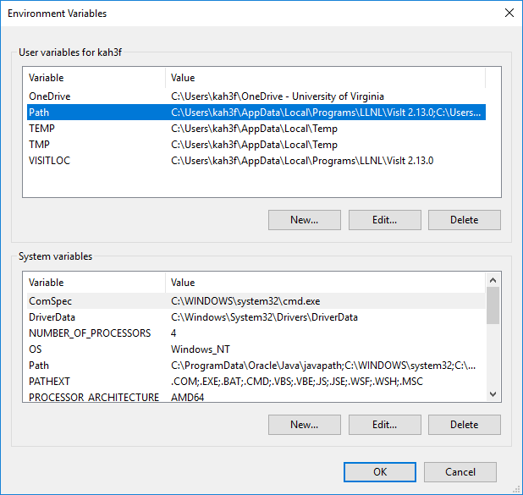
Environment Variables in Windows
Control Panel->System and Security->Advanced system settings->Environment Variables
Once you open Path, click New to add to the Path

Slide 18
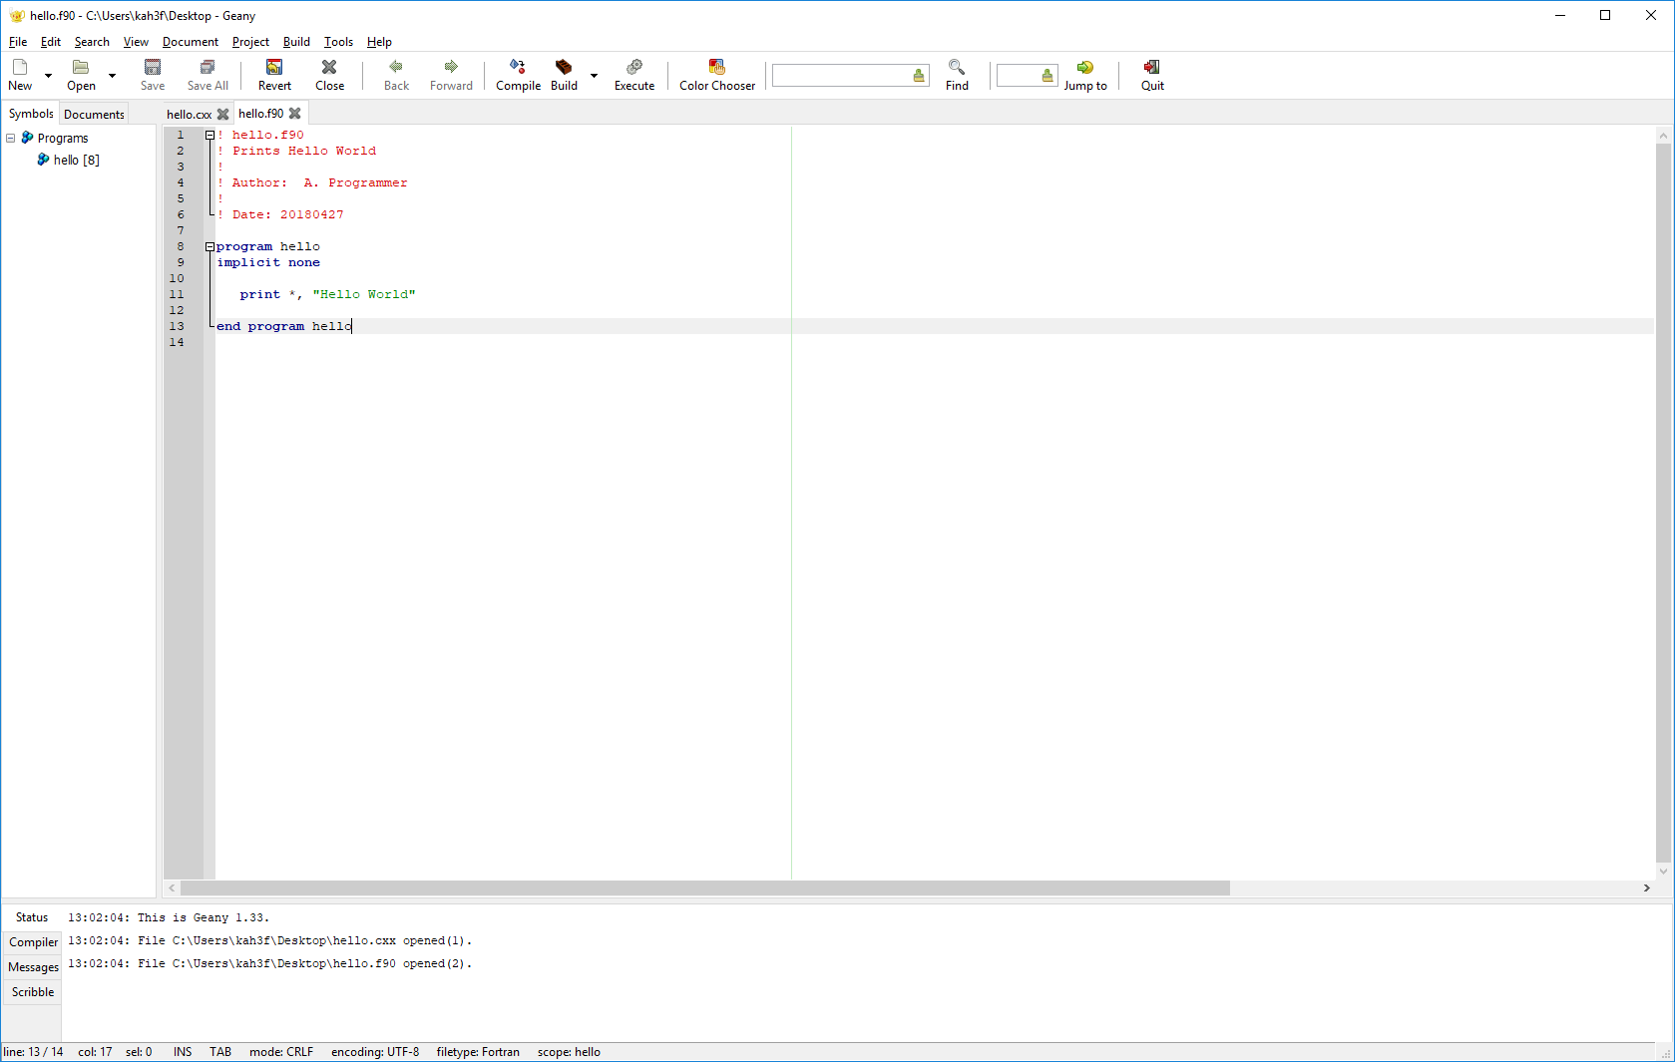
Geany on Windows

Slide 19
Variables in fortran

Slide 20
Variables in Fortran
Unlike most languages, Fortran is not case sensitive. Variables Mean, mean, and even mEan are the same to the compiler.
Like most compiled languages, Fortran is statically typed. All variables must be declared to be of a specific type before they can be used. A variable’s type cannot be changed once it is declared.
Fortran is (nearly) strongly typed. Mixed-mode expressions are limited and most conversions must be explicit.

Slide 21
Numeric Types: Integer
Integer
Quantities with no fractional part
Represented by sign bit + value in binary
Remember that computers do not use base 10 internally
Default integers are of size 32 bits
Maximum integer is is 2³²-1
All Fortran integers are signed
Compiler extension (in nearly all compilers)
INTEGER*8 (old declaration style) is a 64-bit integer
Will show another method when we learn about KIND

Slide 22
Numeric Types: Single Precision
Floating point single precision
Called REAL in Fortran
Sign, exponent, mantissa
32 bits
IEEE 754 defines representation and operations
Approximately 6-7 decimal digits of precision, approximate exponent range is 10⁻¹²⁶ to 10¹²⁷

Slide 23
Numeric Types: Double Precision
Double precision floating point
Sign, exponent, mantissa
64 bits
Number of bits NOT a function of the OS type! It is specified by the IEEE 754 standard!
Approximately 15-17 decimal digits of precision, approximate exponential range 10⁻³⁰⁸ to 10³⁰⁸
In Fortran the default literal is single precision. Double precision literals must include a d/D exponent indicator.
Forgetting to write DP literals with D rather than E often causes a significant loss of precision that is hard to find.

Slide 24
Numeric Types: Complex
A complex number consists of 2 reals enclosed in parentheses
Single-precision type is COMPLEX
z=(r,i)
Most compilers provide the
DOUBLE COMPLEX
extension as a variable type

Slide 25
Non-numeric Types: Logical
Booleans are called logical in Fortran.
Values can be .true. or .false. (periods required)
Are not necessarily represented by integers; internal representation is up to the compiler.
Cannot even be cast to an integer.

Slide 26
Non-numeric Types: Character
Character
1 byte (8 bits) per single character
A character has a fixed length that must be declared at compile time
character(len=8) :: mychar
In subprograms a character of unspecified length may be passed
character(len=*) :: dummy
Fortran 2008 has a variable character length but this is beyond our scope.
Note that character in Fortran really means a fixed-length string. The default length is 1, however.
character :: letter

Slide 27
Literals
Literals aka constants
Specified values e.g.
3
3.2
3.213e0 (Fortran single precision)
3.213d0 (Fortran double precision)
3.213_rk (Determined by kind parameter rk)
"This is a string"
"Isn’t it true?"
'Isn''t it true?'
.true.
(1.2,3.5) (Fortran complex)
Literals have a type but it is determined from the format rather than a declaration.

Slide 28
Variable Declarations
Variables are declared by indicating the type followed by a comma-separated list of variables.
In older code no separator was used.
INTEGER i, j, k
In newer code (including all new code you write) use the double colon to separate the type from the variable list
INTEGER :: i, j, k
If there are other attributes on the line the :: will be required.

Slide 29
Declarations
First statement should be
PROGRAM myname
Then follow it immediately with
IMPLICIT NONE
Declare variables with double-colon syntax
INTEGER :: I, J
REAL :: R, S, T
DOUBLE PRECISION :: D
DOUBLE COMPLEX :: Z
LOGICAL :: FLAG
CHARACTER (len=20) :: C
Line up declarations neatly.
All caps are not required but I use them to emphasize the keywords.

Slide 30
Initializing at Compile Time
Variables can be declared and initialized at the same time:
real :: x=1.e-8, y=42.
When variables are initialized in this manner it happens only once, at compile time. If this takes place in a subprogram it will not happen again upon repeated invocations.
It is equivalent to the older DATA statement
data x,y/1.e-8,42./
In Fortran 2003 it became possible to initialize using intrinsic functions:
real :: pi = 4.0*atan(1.0)

Slide 31
Example
Start Geany, Code::Blocks, or another editor. Type
program first
! My first program
! Author: Your Name
implicit none
real :: x,y
integer :: i,j=11
x=1.0
y=2.0
i=j+2
print *, "Reals are ",x,y
print *, "Integers are ",i,j
end program

Slide 32
PARAMETER
In compiled languages, programmers can declare a variable to have a fixed value that cannot be changed.
In Fortran this is indicated by the PARAMETER attribute.
real, parameter :: pi=3.14159
Attempting to change the value of a variable declared to be a parameter will result in a fatal compiler error.
In older code the declaration and parameter statement will be on different lines
real pi
parameter (pi=3.14159)

Slide 33
Type Conversions
Most compilers will automatically cast numeric variables to make mixed expressions consistent. The variables are promoted according to their rank. Lowest to highest the types are integer, float, double, complex.
Use explicit casting to be clear, or in circumstances such as argument lists where the compiler will not do it.
The new way to cast numbers is via KIND. Older conversion functions such as dble can still be used and will be in older code.
Logicals cannot be cast to anything.
Strings may be cast to numbers and vice versa by a fairly idiosyncratic method.

Slide 34
Examples
Explicit casting among numeric types, default kind.
R=real(I)
I=int(R)
Z=cmplx(r1,r2)
D=dble(R)

Slide 35
Character ⬄ Numeric
Fortran has a peculiar way to do this called internal read/write.
Convert numeric to character:
character(len=4) :: age
integer :: iage
iage=39
write(age,'(i4)') iage
Convert character to numeric
age='51'
read (age,'(i4)') iage

Slide 36
Arithmetic Operations
Operators are defined on integers, floats, and doubles
+ - add subtract
* / multiply divide
** exponentiation
Operator Precedence is:
** (* /) (+ -)
Evaluation is left to right by precedence unless told otherwise with parentheses

Slide 37
Integer Operators
In Fortran 2/3 is always zero! Why?
Because 2 and 3 are both integers. Nothing will be promoted to a float, so / is an integer operation that yields an integer result
Remainder comes from mod(n,d) or modulo(n,d)
mod and modulo are NOT THE SAME for negative numbers
mod is most frequently used though modulo is closer to other languages' % operator. Use for negatives is uncommon in all languages.

Slide 38
Character (String) Operators
Strings/Characters
There are many (some of which require function calls)
Concatenation //
Substring extraction
S(1:3)
The first character is counted as 1 and the last one in the substring is the actual upper bound. This expression extracts characters 1 to 3 inclusive.
Fortran counts from 1 and the upper bound is included in the range.

Slide 39
Conditional Operators
Numeric
Fortran has two sets, one with letters and one with symbols. Note that /= has a / for “not.”
.eq. ==
.ne. /=
.lt. <
.gt. >
.le. <=
.ge. >=

Slide 40
Logical Operators
Negation
.not.
.not. flag
AND
.and.
OR
.or.

Slide 41
Conditional Operator Precedence
>,>=,<,<= outrank == or /=
==,/= outranks .and.
.and. outranks .or.
As always, use parentheses to change grouping or to improve clarity.

Slide 42
Character Comparison Intrinsics
lge(stringA,stringB)
Returns .true. If stringA is lexically greater than or equal to stringB, otherwise returns .false.
lgt(stringA,stringB)
Returns .true. If stringA is lexically greater than stringB, otherwise returns .false.
lle(stringA,stringB)
Returns .true. If stringA is lexically less than or equal to stringB, otherwise returns .false.
llt(stringA,stringB)
Returns .true. If stringA is lexically less than or equal to stringB, otherwise returns .false.

Slide 43
Expressions and Statements

Slide 44
Expressions in Fortran
Fortran expressions are much like those of other languages.
a+3*c
w=8.d0*real(i,dp)+v**3
z=phase+cmplx(0.,1.)
sqrt(abs(a-b))
A .or. B
y > 0.0 .and. y < 1.0
z=myfunc(x,y)

Slide 45
Statements
A Fortran peculiarity: statements are executable or non-executable. Non-executable statements are instructions to the compiler (variable declarations, interfaces, etc.) Executable statements perform some action. All non-executable statements must precede the first executable statements in a program unit.
Indentation is not required but should be used!
No semicolons should be used at the end of the line.
Multiple statements (keep them short) may be written on the same line if they are separated by semicolons.

Slide 46
Fixed Format versus Free Format
Prior to the Fortran 90 standard, Fortran code was required to conform to rigid column rules based on the layout of punched cards.
This may be another reason that computer scientists sneer at it ☺
Statements began in column 7 and could extend to column 72. Column 6 was reserved for continuation marks. Columns 1-5 were for statement labels. Columns 73-80 were ignored (and were used to number cards)
In Fortran 90 and up, there are no column rules. This is called free format.

Slide 47
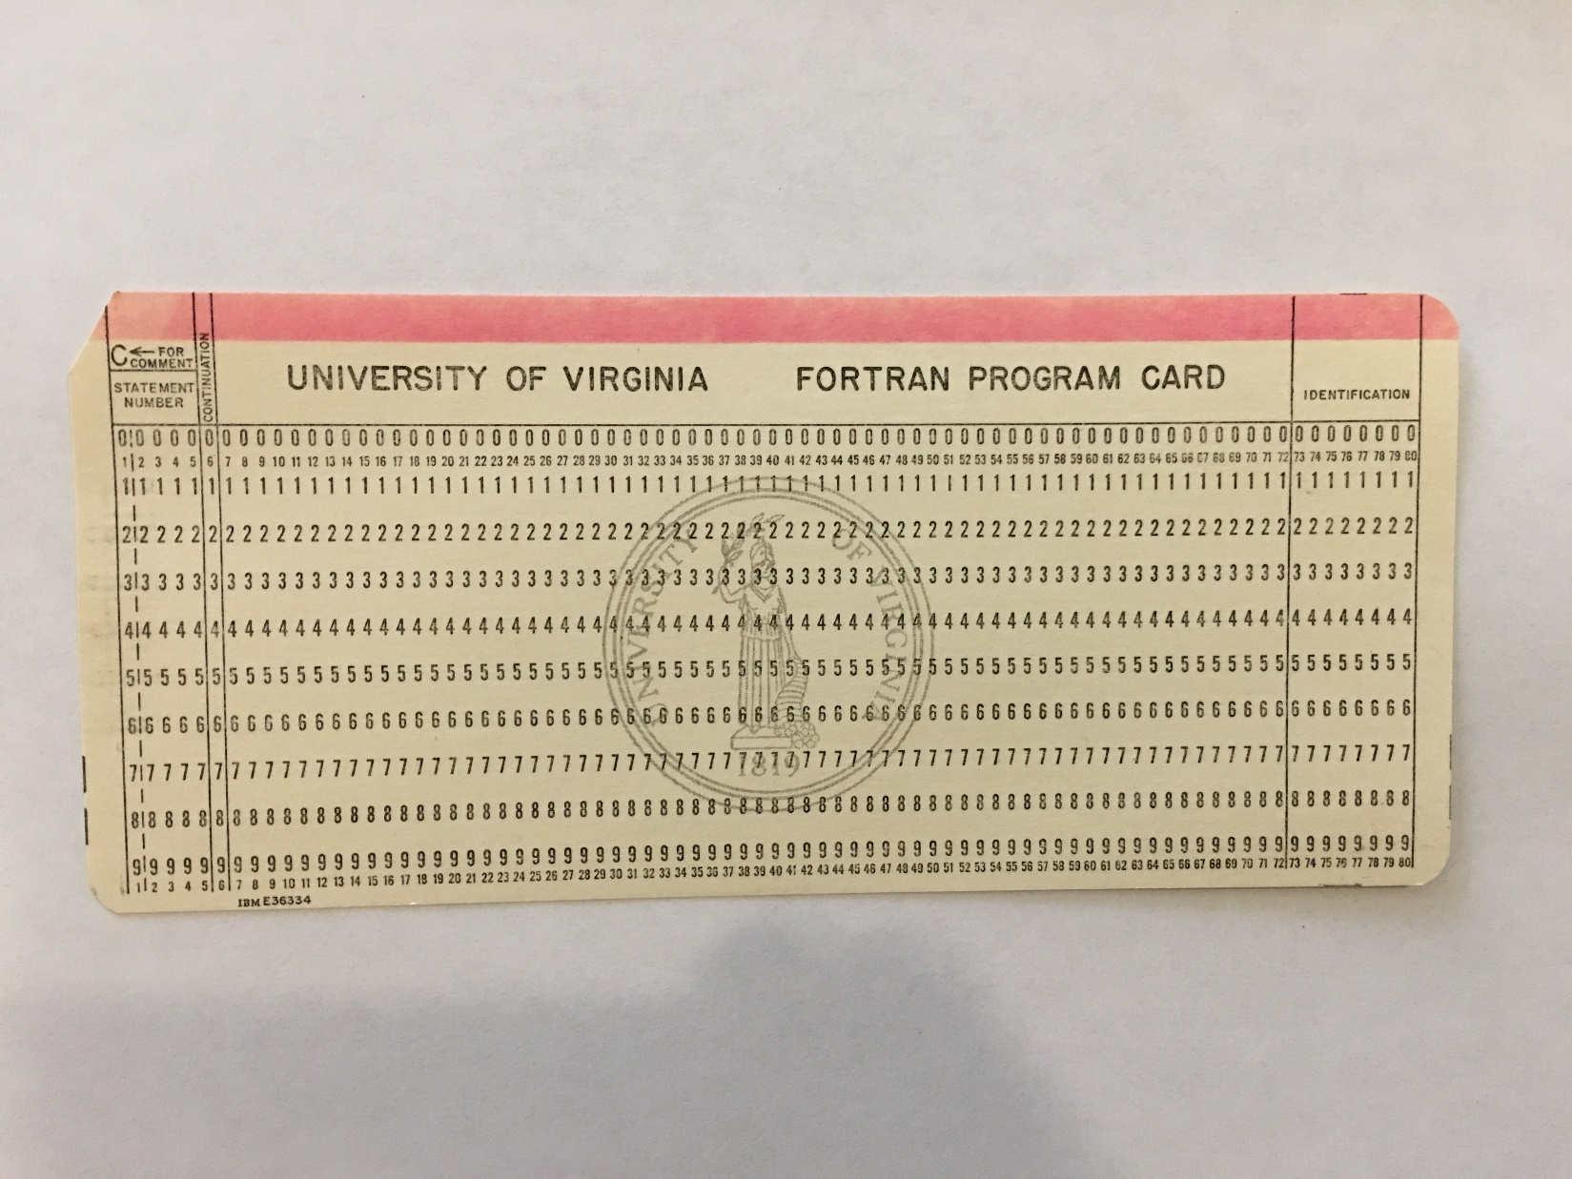

Slide 48
Comments, Continuations, Etc.
Fixed format comment:
C or c in the first column meant the entire line was a comment.
Free format comment:
Anything from ! to the end of the line is ignored.
Fixed format continuation:
Number or printable character in the 6th column.
Free format continuation:
Ampersand & at the end of the line to be continued.

Slide 49
Statements for the Main Program
A program may optionally begin with a PROGRAM statement which is optionally followed by its name.
PROGRAM myprogram
The program must end with an END statement. Optionally it may be
END PROGRAM <name>
I strongly recommend use of the longer, more descriptive forms.
Execution may be stopped with the STOP statement. STOP is required only for abnormal termination. It can optionally be followed by a message, which it will print to standard output.
STOP "Attempt to divide by zero."

Slide 50
IMPLICIT
For historical reasons, Fortran can use implicit typing. By default, variable names beginning in A-H and O-Z are REAL (single precision) while variable names beginning in I-N (the first two letters of INteger) are integers.
IMPLICIT statements change this behavior. Older code often changes the default float to double
IMPLICIT DOUBLE PRECISION(a-h,o-z)
New code should always cancel implicit typing with
IMPLICIT NONE
This requires that all variables be declared and will catch
many “typo” bugs.
The IMPLICIT statement must appear in each program unit.

Slide 51
Statement Labels
In fixed format code, statement labels were often used.
In fixed format statement labels must be integers and must occupy a maximum of five digits, at least one of which must be nonzero.
In free format there is less need for labels and they do not always need to be integers.
Any statement that is not part of a compound (semicolon-separated) statement can be labeled with an integer.

Slide 52
Miscellaneous
The no-op is continue
It was often used in old code since do loops required a labeled statement as the terminator.
do 100 i=1,n
statements
100 continue
We use end do now for this purpose. However, continue is a convenient target for labels in input/output statements.
Fortran has a go to (or goto) statement.
go to <label>
Despite computer science hatred for it, it is still sometimes useful and in some situations it is far more readable than the contortions required to replace it!
As a rule goto should always direct the flow downward, never upward.

Slide 53
Hello World
program hello
implicit none
integer :: i
real :: pi=0.25*atan(1.0)
i=42
print *, 'Hello! The answer is', & i,' and pi is ',pi
end program

Slide 54
Exercise
Write a program that will set variables as indicated and will print the expressions indicated. Use print * to print to the console. Invoke implicit none and declare all your variables.
x=17.
Xs=11.
num_1=10
num_2=14
print *, x
print *, Xs/x
print *, int(Xs/x)
print *, int(Xs)/int(x)
print *, Xs/x + x
print *, Xs/(x+x)
print *, x/num_1
print *, num_1/num_2
print *, num_2/num_1

Slide 55
Exercise
Declare character variables large enough to hold the indicated strings. Make newtitle at least 5 characters longer than you think necessary.
title=“This is a string”
subtitle=“Another string”
print *, len(title)
print *, title//”:”//subtitle
newtitle=title//” : “//subtitle
print *, len(newtitle)
print *, len_trim(newtitle)
print *, newtitle(2:4)
!Change “This” to “That” in newtitle

Slide 56
Exercise
Exercises with conditionals.
Be sure to declare variables appropriately.
a=11.; b=9.; c=45.; n=3
print *, a>b
print *, a<b and c==n
print *, a<b or c==n
print *, a>b or c==n and a<b
print *, (a>b or c==n) and a<b
is_equal= a==b
print *, is_equal

Slide 57
KIND

Slide 58
KIND
Variables in modern Fortran may have a kind associated with them. The programmer requests at least a certain number of decimal digits of precision and at least a certain exponent range, and the system matches the request as best it can.
In practice, most systems have single and double precision. A few offer quad precision (REAL*16 in older nomenclature) but it is usually done in software and is very slow.
Compilers still support REAL and DOUBLE PRECISION (REAL*8 was never standard, but is fairly universally supported). The advantage to KIND is that it becomes easy to change precision, especially when using a module.

Slide 59
Obtaining KIND Information
NEVER assume that the KIND type integer equals the number of bytes. Use intrinsics to obtain or use KIND. The range is 10^{range}
ik=selected_int_kind(range)
rk=selected_real_kind(prec,range)
kind(x) returns the kind type parameter of x
ik=kind(1)
rk=kind(1.0)
dk=kind(1.0d0)

Slide 60
Declaring KIND
For the IEEE 754 standard, the two kinds supported in hardware can be selected with:
INTEGER, PARAMETER :: rk=kind(1.0)
INTEGER, PARAMETER :: rk=kind(1.d0)
The kind variable needs to be a parameter.
Variables are then declared as
REAL(rk) :: r, s, t
Literals can be written as
1.0_rk
Switching between single and double precision is then as easy as replacing the SELECTED_REAL_KIND or KIND statement. It is best to use a module for this purpose.

Slide 61
Type Conversions with KIND
The kind argument is optional except for real converting a floating-point type to another FP type.
aint(a,kind) !truncates a float
anint(a,kind) !nearest integer
ceiling(a,kind)
cmplx(x,y,kind)
floor(a,kind)
int(a,kind) !truncates, casts to integer
nint(a,kind) !nearest integer, casts to integer
real(a,kind)!converts integer to float or & between float types
Example: explicit casting with kind
Given that dp has been declared to match double:
x=real(w,dp)
converts w from single to double precision.

Slide 62
Fortran Loops and Conditionals

Slide 63
Conditionals
elseif/else if and else are optional. The parentheses around the conditional are required.
if ( comparison ) then
code
elseif ( comparison) then
more code
else
yet more code
endif

Slide 64
SELECT CASE
Many else ifs can become confusing.
Expression must be character, integer, or logical
Ranges only applicable for numeric or character expressions
SELECT CASE (expression)
CASE(:value0) ! Expression <= value0
code
CASE(value1)
code
CASE(value2)
code
CASE(value3:) ! Expression >=value3
code
CASE (value4,value5,value6) !Multiples OK
code
CASE (value7:value9)
code
CASE DEFAULT ! Optional
code
END SELECT

Slide 65
SELECT Example
select case (x)
case (:0)
y=-x
case (1)
y=x+3.
case (2:9)
y=float(x)/2.
case (10:20)
y=float(x)/3.
case default
y=0.
end select

Slide 66
DO Loop
DO is the equivalent of FOR in languages like C/C++.
DO executes a fixed number of iterations unless explicitly terminated.
DO can iterate only over integer sequences.
INTEGER :: L, U, S
INTEGER :: I
DO I=L,U,S
…
END DO
I: Loop variable
L: Lower bound
U: Upper bound
S: Stride. Equal to 1 if not present
S can be negative, in which case L must be greater than U.

Slide 67
QUIZ
The standard requires that loop variables be integers. How would I implement loop variables that are real?
How might real loop variables be a problem?

Slide 68
Implied DO
The implied do is used in a few circumstances, specifically input/output and array construction.
(var(iterator),iterator=lbound,ubound,s)
The parentheses are required.
(a(i),i=1,20)
Implied do loops can be nested.
((r(i,j),j=1,M),i=1,N)

Slide 69
Early Exit
exit: leave loop
exit is able to break out of only the loop level in which it appears. It cannot break from an inner loop all the way out of a nested set of loops. This is a case where goto is better than the alternatives. Equivalent to Python/C/C++ break
cycle: skip rest of loop and go to next iteration. Equivalent to Python/C/C++ continue

Slide 70
WHILE Loops
do while (<logical expression>)
statement
statement
…
end do
Remember that your logical expression must become false at some point.

Slide 71
Example
integer :: x, y, z
x=-20
y=-10
do while (x<0 .and. y<0)
x=10-y
y=y+1
z=0
enddo
z=1

Slide 72
Exit/Cycle
x=1.
do while (x>0.0)
x=x+1.
if (x>=10000.0) exit
if (x<100.0) cycle
x=x+20.0
enddo

Slide 73
Repeat-Until
do
statement
statement
….
if (<logical expression>) exit
end do
do while always tests at the top of the loop. The do … if/exit form can test anywhere.

Slide 74
Example
Reading a file of unknown length
nlines=0
do
read(unit=iunit, end=10) var
nlines=nlines+1
enddo
10 continue

Slide 75
Example
program second
implicit none
integer :: x, y, z
x=-20
y=-10
do while (x<0 .and. y<0)
x=10-y
y=y+1
z=0
enddo
z=1
print *, x, y, z
end program

Slide 76
Exercise
Loop from 0 to 20 by increments of 2. Make sure that 20 is included. Print the loop variable at each iteration.
Start a variable n at 1. As long as n is less than 121, do the following:
If n is even, add 3
If n is odd, add 5
Print n for each iteration. Why do you get the last value?
Set a real value x=0. Loop from 1 to N inclusive by 1.
If the loop variable is less than M, add 11. to x.
If x > w and x < z, skip the iteration.
If x > 100., exit the loop.
Experiment with different values for the variables. Start with N=50, M=25, w=9., z=13.

Slide 77
Arrays

Slide 78
Terminology
A scalar is a single item (real/float, integer, character/string, complex, etc.)
An array contains data of the same type with each scalar element addressed by indexing into the array.
An array has one or more dimensions. The bounds are the lowest and highest indexes. The rank is the number of dimensions.
Fortran arrays are similar to NumPy arrays and also carry metadata (shape, size, bounds, some other data) about themselves.

Slide 79
Fortran Arrays
Arrays must be declared by type and either by size or by some indication of the number of dimensions.
We will do variable dimensions later
REAL, DIMENSION(100) :: A
By default the index starts at 1. However, it can start at any integer less than the upper bound:
REAL, DIMENSION(-1:101,0:3) :: A0
Arrays may have zero size.
Maximum (standard) dimensions <=F2003 is 7. Increases to 15 in F2008.

Slide 80
Orientation
Array elements are adjacent in memory (this is one of their advantages) and are arranged linearly no matter how many dimensions you declare. If you declare a 3x2 array the order in memory is
(1,1), (2,1), (3,1), (1,2), (2,2), (3,2)
“Orientation” refers to how the array is stored in memory, not to any mathematical properties.
Fortran is column-major oriented. Most other languages are row-major oriented.
Loop indices should reflect this whenever possible (when you need loops).
Fortran: outermost first. Go right to left.
A(i,j,k) loop order is do k/do j/do i

Slide 81
Array Elements and Slices
Each element can be addressed by its index or indices, enclosed in parentheses.
A(3)
X(i,j)
Remember, starts at 1 by default
Slices (subarrays)
REAL, DIMENSION(100) :: A
REAL, DIMENSION(12) :: B
INTEGER, DIMENSION(20,10) :: N
INTEGER, DIMENSION(20) :: C
B=A(1:12)
C=N(:,i) !ith column of N

Slide 82
Array Initialization
Arrays can be initialized to the same quantity by an array operation
A=0.0 !equivalent to A(:)=0.0
For small arrays, an array constructor can be written.
I=[1,0,0,0]
The constructor can use a construct called an implied do (which is somewhat similar to a Python list comprehension):
X=[(real(i),i=1,100)]

Slide 83
Array Operations
Most of the mathematical functions are overloaded to accept array arguments. They operate on the array(s) elementwise.
T=3.0
A=3.14159*I
B=sin(A)
C=A/B !Watch out for zero elements

Slide 84
Array Intrinsics
Modern Fortran has many intrinsic functions that operate on arrays.
Array intrinsics can be classified as inquiry, construction and manipulation, and transformation/reduction.

Slide 85
Array Construction Intrinsics
reshape(source,shape[,pad][,order])
merge(array1,array2,mask)
pack(array,mask [,vector])
unpack(vector,mask,field)
spread(source,dim,ncopies)

Slide 86
Array Inquiry Intrinsics
allocated(array)
returns .true. or .false.
lbound(array), ubound(array)
shape(array)
returns a rank-one array containing the dimensions
size(array,[dim])
returns the size (the total number of elements). If the optional argument dim is not present it returns the total number of elements; if dim is present it returns the number of elements on that dimension.

Slide 87
Array Transformation Intrinsics
transpose(matrix)
matrix must be square and rank 2
dot_product(V1,V2)
both must be rank 1
matmul(A,B)
A and B must conform, must return a rank-2 array even if it’s (1,1)
Note: depending on compiler and version, might be slow
minloc(array [,mask]) !first one it finds
minloc(array, dim [,mask])
maxloc (as above)
minloc/maxloc return a rank-1 array of indices.

Slide 88
Array Reduction Intrinsics
minval(A [,dim])
maxval(A [,dim])
all(mask [,dim])
any(mask [,dim])
count(mask)
product(A [,dim])
sum(A [,dim])
Example: A has shape (4,5,6)
sum(A,2) has shape (4,6) and elements sum(A(i,:,j))
->Same behavior as similar NumPy built-ins.

Slide 89
Example
Open a new file (you can call it arrays.f90) and type
program arrays
! Array demo
implicit none
real, dimension(100) :: A
real, dimension(10,10) :: B
integer, dimension(2) :: shaper=[10,10]
integer :: i
A=[(0.1*real(i),i=1,100)]
B=reshape(A,shaper)
print *, B(1:3,1:4)
end program

Slide 90
Allocatable Arrays
Arrays may be sized at runtime by making them allocatable. They are declared with an allocatable attribute and a colon for each dimension.
REAL, ALLOCATABLE, DIMENSION(:) :: A, B
If any dimension is allocatable, all must be.
They must be allocated before they are used, so their size must be known at runtime.
ALLOCATE(A(NMAX),B(MMAX))
Check whether an array is allocated with allocated(A)
if (allocated(A)) then
do something
endif

Slide 91
Exercise
In arrays.f90
Print the size of the array A
Change the fourth element to 1.1
Declare a new real array W of rank 2 (two dimensions) and make it allocatable. Allocate the array to size 10x10 and set all values to 1.0 using an array operation.
Use a nested loop to set each element of W(i,j) to the sum of its row and column indices. Fortran loops should run over indices from right to left, e.g.
do j=1,N
do i=1,M
A(i,j)=something
enddo
enddo

Slide 92
Masking Array Operations
Masks can be constructed and used to perform bulk operations on arrays.
real, dimension(100):: x
assign x somehow
if ( all(x>=0.0) ) then
y=sqrt(x)
endif

Slide 93
Advanced Array Indexing
Arrays can be addressed with arrays of integers (but not logicals).
integer, dimension(1) :: maxtemp
real, dimension(365) :: temps
character(len=5),dimension(365) :: dates
maxtemp=maxloc(temps)
print *, "maximum temp was at ",dates(maxtemp)

Slide 94
Conditionals with Arrays
Logical arrays can be assigned with conditionals derived from other arrays to construct masks.
logical, dimension(365) :: is_max
integer :: day
is_max=temps==maxval(temps)
do day=1,size(is_max)
if (is_max(day)) then
print *, dates(day)
endif
enddo

Slide 95
Where
Where functions like a “vectorized” loop+conditional.
The clauses must be array assignments.
where ( A>=0.0 )
B=sqrt(A)
elsewhere
B=0.
end where

Slide 96
Exercise
In arrays.f90
Add a WHERE to set elements to W equal to the corresponding elements of B if the element of B is less than 7.

Slide 97
Fortran input/output

Slide 98
List-Directed IO
List-directed IO allows the compiler to format the data.
Input
Fortran read from standard input. Separates values on comma or whitespace.
read(*,*) var1, var2, var3
Fortran write to standard output
print *, var1,var2,var3
write(*,*) var1,var2,var3
In Fortran the print statement always writes an EOL after all variables have been output. The write statement does as well unless told otherwise (this is the opposite of write in most other languages).

Slide 99
Reading from the Command Line
We can read strings only. You must convert if necessary to a numerical type using internal read/write.
nargs=command_argument_count()
if ( nargs .ne. 1 ) then
stop "No input specified"
else
call get_command_argument(1,nval)
read(nval,'(i4)') n
endif

Slide 100
Formatted IO
In Fortran it is best to avoid formatted input as much as possible, as it can lead to errors.
Formatted output, on the other hand, is frequently required for legibility. Compilers tend to let list-directed output sprawl.
Formatted output is similar to other languages (in fact, they all got it from Fortran, the oldest higher-level programming language).

Slide 101
Edit Descriptors
The edit descriptor modifies how to output the variables. They are combined into forms like
RaF.w
where R is a repeat count, a is the descriptor, F is the total field width including space for +-, and if requested +-e and exponent, and w is the number of digits to the right of the decimal point. Ra.w alone works and Ra.0 will print the integer part.
Strings take only F (RaF) and do not usually require the F since the length will be known to the compiler.
Integers can be written as iF and any of the F spaces not needed will be blank filled, with the digits right justified. When written as iF.m they will be printed with at least m digits and the rest of the field zero-filled on the left if all of F is not needed.

Slide 102
Common Edit Descriptors
As usual, they are not case sensitive.
I integer
F real (decimal output)
E real (exponential output)
G general
D double precision (prints D rather than E for exponent)
A character (does not require a field width in most cases)
X space
The real descriptors F, E, G, and D all work for both single and double precision. G allows the compiler to choose whether to use decimal or exponential format.

Slide 103
Modifiers
Some modifiers can change the appearance of the output.
p multiply by 10. kp multiply by 10^{k}. Applies till the next scale factor is encountered.
ES use scientific notation. The default exponential format writes in machine normalization, with the leading digit between 0 and 1. ES causes it to write with the leading digit between 1 and 9, which is what most humans can read most easily. Ignores p on output.
/ write an EOL and go to the next line (record) within the format

Slide 104
Format Strings
The format string is constructed as a list of how to output the variables. Unlike some other languages, literal strings are never included, but must have their own edit descriptors.
The format string can be placed directly into the write statement or it can be in a separate format statement. In the write it is enclosed in parentheses and quotes.
For most purposes it is best to put the format string into the write statement. The format statement is older and will be in old code, but it is usually harder to see what is happening. It is useful for particularly long strings, however.

Slide 105
Examples
write(*,'(i5,2x,i6)') i1,i2
write(*,'(i5,a,i6)')) i1," ",i2
write(*,'(a,i4,es15.7)') "row",n,var
write(*,'(3(i2,3x,f8.3)') (r(j),var(j),j=1,3)
write(*,'(2f8.2)') z !complex
write(*,'(2L)') is_zero,is_finite
write(*,'(2p,f8.2,0p,f8.2)') var1, var2
write(*,'(a,f8.2,/,a,i6)') mess1,x,mess2,i

Slide 106
Format Statements
Format statements are abundant in older code, before the strings could be inserted into writes.
FORMAT is non-executable but can appear anywhere in the source. It is the only non-executable statement that can do so.
It can still be useful for a particularly complex format (to keep the write statement short and readable) or for formats that are repeated in many write statements.
The second parameter to the write is then an integer statement label. The label marks the format statement.

Slide 107
Format Example
write(*,100) x,y,z
100 format(3e15.8)
Traditionally the format is placed immediately below the line which refers to it, or else all format statements are grouped together just before the end statement of their program unit.

Slide 108
Fortran Non-Advancing IO
If we’d like to write to and read from standard input on the same line we can use non-advancing IO:
write(*,'(a)',advance='no') "Enter input value:"
read(*,*) value
Must be formatted
‘yes’ for advance is valid also but is the default.
Argument to advance can be a character variable so you can decide based on conditionals to advance or not.

Slide 109
Exercise
Write a program that computes pi using a trig identity such as π=4*atan(1)
Use kind to switch between real and double precision
integer, parameter :: rk=kind(1.0) or (1.0d0)
Using single precision, print pi in
E format
Scientific notation
Scientific notation with 8 decimal places
Repeat for double precision

Slide 110
Exercise
In an “infinite” while loop:
Request an integer from the user with non-advancing input/output, e.g.
“Please enter an integer:” <then read integer>
If the integer is 1, print “zebra”. If it is 2, print “kangaroo”. If it is anything else except for zero, print “not found”. If it is 0, exit the loop.

Slide 111
Fortran file io

Slide 112
Open
Files are identified with integers called unit numbers.
open(unit=iunit,file=fname,end=10)
There are many other options. Only iunit and fname are required. If the unit argument is first it does not need the "unit=" keyword.
On Unix file names will be case sensitive.
The unit number is assigned by the programmer.
In Unix unit 5 is conventionally standard input and unit 6 is standard output. Standard error is not as uniform but it is usually unit 2.
Programmers can reassign units 2, 5, and 6, but it is strongly advised that you not do so.

Slide 113
Popular Options to Open
iostat=ios
Returns status into the integer variable ios. If zero the statement succeeded, otherwise it failed. Specific nonzero values are system-dependent.
err=label
Jumps to statement labeled label if an error occurs.
end=label
Jumps to statement labeled label on end of file
status=stat
stat can be 'old', 'new' , 'replace', 'scratch', or 'unknown'. The default is 'unknown' (read/write). If 'old' it must exist, and if 'new' it must not exist. A 'scratch' file is automatically deleted after being closed.
form=fmt
fmt is 'formatted' (default, text) or 'unformatted' (a system-dependent binary format).
access=acc
acc can be 'sequential' (default), 'direct', or 'stream'. Direct files must be unformatted.
Unless access is stream, an unformatted file will have a header and footer that is specific to a compiler and platform and may not be portable.
position=pos
pos is 'asis'(default), 'rewind', or 'append'. Rewind returns the file pointer to the top. Append leaves it at the end of the file.

Slide 114
Inquire
The inquire statement tests the status of a file. Most usually we wish to check whether the file exists, or is already open, before we attempt to open it.
inquire(unit=iunit,options)
or
inquire(file=fname,optionslist)
So we can inquire by unit or name but not both.

Slide 115
Common Options to Inquire
iostat=ios
Like open
err=label
Like open
exist=exists
Returns .true. or .false. into logical exists
opened=is_open
Returns .true. or .false. into logical is_open

Slide 116
Close
Much of the time, it is not necessary to close a file explicitly. Files are automatically closed when execution terminates.
If many files are opened, it is good practice to close them before the end of the run.
close(unit=iunit,iostat=ios,err=ier,&
status=st)
Status can be ‘keep’ (default) or ‘delete’
close(iunit)

Slide 117
REWIND
An open unit can be rewound. This places the file pointer back to the beginning of the file.
The default is to rewind a file automatically when it is closed.
If you want to rewind the file to reread it, use
rewind(iunit)
Rewind is convenient if the program must handle files whose lengths may vary. Read through the file without storing any variables, count the number of lines, rewind, then allocate any arrays needed.
If your input files will always be of known length this isn’t necessary (or efficient), but often file length could vary with different data.

Slide 118
Example
nlines=0
do
read(iunit,*,end=1)
nlines=nlines+1
end do
1 continue
rewind(iunit)
allocate(obs(nlines))
do n=1,nlines
read(iunit,*) obs(n)
enddo
QUIZ
Why do I increment nlines after the read?
What would I do if I had one or more header lines?

Slide 119
Reading from a File
READ(iunit,*)
For the most part I do not recommend formatted input, but if it is required it is
READ(iunit,'(fmtstr)'))
or
READ(iunit,label)
label FORMAT(fmtstr)
Each READ statement reads one line (unless you provide a format string and insert a forward slash).

Slide 120
Writing to a File
WRITE(iunit,*)
List IO
WRITE(iunit,'(fmtstr)')
or
WRITE(iunit,label)
label FORMAT(fmtstr)
label must be an integer
Fortran always writes an EOL for each WRITE statement; you may add more with the / character but there is seldom a need for this.
If you do not want to advance, use advance='no'

Slide 121
Fortran Namelist
One of the most convenient I/O statements in Fortran is NAMELIST. With this statement, parameters in an input file can be specified by name=value and in any order.
The namelist must be declared. This is a non-executable statement. Syntax:
NAMELIST /name/ var1,var2,var3
The name is chosen by the programmer.
The namelist is read with a special form of the READ statement
read(iunit, name)

Slide 122
Namelist Input
The input file containing the namelist must follow a specific format. Namelist was not part of the Fortran 77 standard (it was standardized in Fortran 90) so there is some variation. However, the namelist always starts with
&name
The variable list follows, with each variable on a separate line and consisting of the varname=value pair.
In older code, the namelist frequently ends with another ampersand (&), or &end. Also, in Fortran 77 there may be rules about in which column the & can occur.
In Fortran 90, the namelist is terminated with a forward slash /

Slide 123
Namelist Example
In the program
NAMELIST /params/ rho, eps, x0
OPEN(10,file='paramlist.txt
')
READ(10,params)
The input file (Fortran 90 format)‏
&params
rho=1.3
eps=1.e-7
x0=0.0
/

Slide 124
Example
program third
character(len=80) ::infile,outfile
character(len=40) ::common_name,common_name_adj
character(len=20) ::species_id
logical ::file_exists
real, dimension(:), allocatable ::num_obs,years
integer ::ios
nargs=command_argument_count()
if (nargs .ne. 1) then
stop "No data file specified"
else
call get_command_argument(1,infile)
endif
inquire(file=infile,exist=file_exists)
if (.not. file_exists) then
stop "Data file not found"
endif
iunit=11
open(iunit,file=infile,iostat=ios)
if (ios .ne. 0) then
stop "Cannot open file"
endif

Slide 125
Example (Continued)
nlines=0
do
read(iunit,*,end=10)
nlines=nlines+1
enddo
10 continue
rewind(iunit)
! Subtract header line
nyears=nlines-1
allocate(years(nyears),num_obs(nyears))
!Read header
read(iunit,*)
!Read data (only the values of interest)
!Species info is the same on all lines so we dont make an array
do n=1,nyears
read(iunit,*,iostat=ios) species_id,common_name_adj, common_name, years(n), num_obs(n)
if (ios .ne. 0) stop "Error reading file"
enddo
!Adjust years to absolute number (known in advance)
years=years+1900
print *, "Read observation ",num_obs(85)," for year ",years(85)
end program

Slide 126
Exercise
Write a program that creates a file mydata.txt containing four rows consisting of
1, 2, 3
4, 5, 6
7, 8, 9
10, 11, 12
Rewind the file and read the data back. Write a loop to add 1 to each value and print each row to the console.

Slide 127
Subprograms

Slide 128
What is a Subprogram
A subprogram is a self-contained (but not standalone) program unit. It performs a specific task, usually by accepting parameters and returning a result to the unit that invokes (calls) it.
Subprograms are essential to good code practice. Among other benefits, they are
Reusable. They can be called anywhere the task is to be performed.
Easier to test and debug than a large, catch-all unit.
Effective at reducing errors such as cut and paste mistakes.

Slide 129
Functions and Subroutines
Unlike most languages, Fortran makes a distinction between functions and subroutines.
Functions take any number (up to compiler limits) of arguments and return one item. This item can be a compound type.
Functions must be declared to a type like variables. (Better: use an interface.)
Subroutines take any number of arguments (up to the compiler limit) and return any number of arguments. All communication is through the argument list.
If they are in the same file as the calling unit, subprograms follow the caller.

Slide 130
INTENT
In order to manage side effects, Fortran 90 introduced INTENT for declaring subprogram parameters.
<type> INTENT(<state>) :: param
where state can be in, out, or inout.
<type> INTENT(in) :: param
It is illegal to change a parameter declared INTENT(in)
<type> INTENT(out) :: param
The compiler will warn if a parameter declared INTENT(out) is never changed.
<type> INTENT(inout) :: param
INTENT(inout) means that the programmer intends to overwrite the parameter. Thus the programmer makes clear that the side effect is desired or necessary. Parameters passed down to other subprograms must be inout.
Always use INTENT in your programs.

Slide 131
Functions
The return value is indicated by assigning to the name of the function.
FUNCTION myfunc(param1,param2,param3,param4)
<type> :: myfunc
<type>, INTENT(in) :: param1, param2
<type>, INTENT(in) :: param3, param4
statements
myfunc=whatever
return !Optional unless premature
END FUNCTION myfunc

Slide 132
Alternative Declaration
<type> FUNCTION & !continuation due to PPT
myfunc(param1,param2,param3,param4)
<type>, INTENT(in) :: param1, param2
<type>, INTENT(in) :: param3, param4
statements
myfunc=whatever
return !Optional unless premature
END FUNCTION myfunc

Slide 133
Renaming the Result
Normally the function value is returned by assigning a value to the name of the function.
We can return it in a different variable with the RESULT clause.
function summit(x,y) result(s)
Especially used for recursive functions (it is required in this case until F2008).
When using RESULT we declare the type of the name of the RESULT rather than the name of the function.

Slide 134
Example
FUNCTION myfunc(param1,param2)RESULT value
<type> :: value
<type>, INTENT(in) :: param1, param2
<type>, INTENT(in) :: param3, param4
statements
value=whatever
return !Optional unless premature
END FUNCTION myfunc

Slide 135
Subroutines
SUBROUTINE mysub(param1,param2,param3)
<type> INTENT(in) :: param1
<type> INTENT(out) :: param2
<type> INTENT(inout) :: param3
statements
return ! Optional unless premature
END SUBROUTINE mysub

Slide 136
Invoking Functions and Subroutines
Function
Invoke by its name
x=myfunc(z,w)
y=c*afunc(z,w)
A function is just like a variable except it cannot be an lvalue (appear on the left-hand side of =)
Subroutine
Use the call keyword
CALL mysub(x,y,z)

Slide 137
Passing by Reference
Fortran passes all parameters by reference, meaning that the memory location holding the variable (or its starting position) is what is actually passed.
This means that any argument can be changed by the subprogram and it will be changed in the caller as well. This is a side effect.
Subroutines operate entirely by side effects.
Sometimes this is not called a “side effect” when it is intentional, only when it is unintentional.

Slide 138
Exercise
1. Write a function that computes Euclidean distance between points x1,y1 and x2,y2. Fortran has a built-in sqrt intrinsic that you should use.
Write the main program to call this function for
x1=-1, y1=2, x2=3, y2=5
x1=11,y1=4, x2=7, y2=9
2. Given two points x1,y1 and x2,y2, write a subroutine to determine which is closer to a third point x3,y3. It should pass back a message. You can pass in the points and call the Euclidean distance function from the subroutine, or you can pass in the two distances. (The former would be better programming but if you feel uncertain please go ahead and compute distances separately for now.) Test with
x3=10, y3=5
You will need to declare the function name in the calling unit as if it were a variable, e.g.
real eu_dist

Slide 139
Passing Arrays to Subprograms
Arrays may be passed in one of three ways.
Static
Dimensions are declared as fixed numbers in both calling unit and callee.
Automatic
Dimensions may be passed in the argument list
Assumed-Shape
Only the rank is given, with an appropriate number of colons.

Slide 140
Examples
real, dimension(100) :: A
call sub(A)
subroutine sub(A)
real, dimension(100) :: A ! in sub
real, dimension(n) :: A
call sub(A,n)
subroutine sub(A,n)
real, dimension(n) :: A ! in sub
integer :: n
real, dimension(n) :: A
call sub(A)
subroutine sub(A)
real, dimension(:) :: A ! in sub

Slide 141
Local Arrays
Arrays that are local to a subprogram may be sized using an integer passed to the subprogram
double precision function myfunc(A,n)
integer, intent(in) :: n double precision, dimension(n), intent(in) :: A
double precision, dimension(n) :: B

Slide 142
Interfaces
If your subprogram is not in a module (to be covered later) you should provide an INTERFACE.
The INTERFACE is equivalent to the prototype of some other languages.
Interfaces enable the compiler to check that the number and type of the argument list in invocations agrees with the declared parameter list.
Interfaces are nonexecutable and should be placed with (or after) variable declarations.

Slide 143
Syntax
INTERFACE
function myfunc(x,y,z)
implicit none
real :: myfunc
real :: x,y
complex :: z
end function myfunc
END INTERFACE

Slide 144
More Interfaces
INTERFACE
SUBROUTINE mysub(x,y,z)
use mymod
implicit none
<type> :: x
<type> :: y,z
END SUBROUTINE mysub
END INTERFACE

Slide 145
Interface Blocks
Only one interface block is required per program unit.
INTERFACE
function mysub
declarations
end function mysub
subroutine mysub1
declarations
end subroutine mysub1
subroutine mysub2
declarations
end subroutine mysub2
END INTERFACE

Slide 146
Exercise
Correct your previous exercise with Euclidean distance function and subroutine to use an interface. Each calling unit must have an interface for every subprogram it calls.
The interface replaces declarations of the type of the function name.

Slide 147
Saving and Deallocating
According to the standard, local variables in a procedure are deallocated upon exit from the procedure.
Allocatable local arrays are automatically deallocated (a form of “garbage collection”)
If you need some local variables to retain their value from one call to another, use the SAVE keyword
SAVE var1, var2, var3
SAVE
With no variable list it saves all variables
Allocatable local arrays cannot be saved.

Slide 148
Passing a Subprogram Name
The name of a subprogram can be passed to another subprogram.
Example: a numerical-integration subroutine needs the function to be integrated.
subroutine trap(f,a,b)
where f is a function.
The unit in which the subprogram receiving the name is called must have an interface for the subprogram to be passed.

Slide 149
Optional and Keyword arguments

Slide 150
Optional Arguments
Subroutines and functions may take optional arguments. Such arguments need not be passed. If they are passed, they take on the passed value. They are declared with the OPTIONAL attribute.
subroutine mysub(x,y,z,w)
implicit none
real, intent(in) :: x,y
real, intent(in), optional :: z,w

Slide 151
Using Optional Arguments
The call to the previously-defined subroutine could be
call mysub(a,b)
in which case c and d would have no values and the subroutine would need to handle that situation appropriately. The call could also be
call mysub(a,b,c)
or
call mysub(a,b,c,d)
depending on how many of the optional arguments needed to be passed.

Slide 152
Keyword Arguments
Suppose it were desired to pass d but not c in the preceding subroutine. The c parameter can be skipped by using a keyword argument; the optional argument is called as
dummy=actual
where dummy is its name in the program unit where it is defined, and the actual argument is its name in the calling program unit.
Example:
call mysub(aa,bb,w=d)
Positional (non-optional) arguments must appear before any optional or keyword arguments.

Slide 153
The PRESENT Intrinsic
The PRESENT() intrinsic function tests whether a particular optional argument is present in the argument list of the caller. If it is not present, defaults can be set or other action taken.
Example
IF (PRESENT(w)) then
dd=w
ELSE
dd=3.14
ENDIF

Slide 154
Pure and elemental procedures

Slide 155
PURE Functions
Side effects should be avoided in functions. Fortran offers subroutines to handle situations where changes to the parameters make sense.
The programmer can declare a function PURE to tell the compiler it is free of side effects.
pure function myfunc(x)
integer :: myfunc
real, intent(in) :: x
Pure functions must declare all parameters intent(in).

Slide 156
PURE Procedures
Subroutines may also be PURE. They may change their parameters but should declare those as intent(out).
PURE procedures must have an interface.
Any additional procedures they call must be PURE
Neither pure functions nor pure subroutines are permitted to
Alter any accessible global variables (e.g. from contains)
Perform any IO
SAVE any variables
Contain any STOP statement

Slide 157
ELEMENTAL Procedures
PURE procedures were intended for automatic parallelization. However, a particularly useful derivative is the ELEMENTAL procedure.
ELEMENTAL procedures operate elementwise on arrays.
All ELEMENTAL functions must obey the rules for PURE functions. Arguments must be scalars.
elemental function f2c(tempF)
real :: f2c
real, intent(in) :: tempF
f2c=(tempF-32.)/1.8
end function f2c

Slide 158
Using ELEMENTAL Procedures
real :: tempF, tempC
real, dimension(100) :: tempFs, tempCs
real, dimension(10,10):: dataF, dataC
tempC = f2c(tempF)
tempCs= f2c(tempFs)
dataC = f2c(tempCs)
The elemental function can be called for any arrays as long as they conform. Each element is modified by the function appropriately. It can also be called as a normal scalar function.

Slide 159
Exercise
Write an elemental function that accepts a single parameter as an angle in degrees and converts it to radians.
Write a program that computes the cosine of 0 to 90 degrees in increments of 5 degrees. Print the output. Do it with a loop, and then by creating a one-dimensional array of angles and passing it to the function.

Slide 160
SCOPE

Slide 161
Variable Scope
In Fortran, scope is defined by the program unit.
A calling unit may have a variable named x, and a function may also have a variable named x, and if x is not an argument to the function then it will be distinct from the x in the calling unit.
x=20.
call sub(x)
etc.
subroutine sub(y)
real, intent(inout) :: y
real :: x
x=10.
y=30.
end subroutine sub

Slide 162
CONTAINS and Nested Procedures
The contains keyword extends the scope into the contained program unit.
The end of the “container” must follow the end of the “containee”
A contained subprogram can access all the variables in the container except those that are explicitly passed.
The interface is implicit and should not be made explicit.
Contained procedures are often said to be nested.
Only one level of nesting is permitted.

Slide 163
Example
program myprog
implicit none
real :: x,y,z
x=5.; y=10.
call mysub(z)
contains
subroutine mysub(w)
real, intent(inout) :: w
w=x+y
end subroutine mysub
end program myprog

Slide 164
Common
COMMON is a deprecated feature that is frequently seen in older code. It is a means of providing global variables. Syntax:
common /comname/ var1, var2, var3
The variables in the common list will be available to any program unit that includes the above line. Variables in common between two program units should not be passed as subroutine parameters.
Newer code should use modules rather than common.

Slide 165
Pitfalls with Common
The common statement must be in every program unit that will share the variables, and it must be identical in each one. It is highly recommended that any code using common put each one into a separate file and use the include statement to merge the files. INCLUDE is a standard Fortran statement, not a preprocessor statement; its syntax is
include 'file.h'
where file.h can be any name (Fortran does not have a rule about file extensions for included files).
COMMON is a frequent source of memory errors.
COMMON makes interface control difficult to impossible.

Slide 166
Compilers, Linkers, and Make

Slide 167
Building an Executable
The compiler first produces an object file for each source file. In Unix these end in .o
Object files are binary (machine language) but cannot be executed. They must be linked into an executable.
If not told otherwise a compiler will attempt to compile and link the source file(s) it is instructed to compile.
For Unix compilers the -c option suppresses linking. The compiler must then be run again to build the executable from the object files.
The option -o is used to name the binary something other than a.out

Slide 168
Linkers and Libraries
When the executable is created any external libraries must also be linked.
The compiler will search a standard path for libraries. On Unix this is typically /usr/lib, /usr/lib64, /usr/local/lib, /lib
If you have others you must give the compiler the path. -L followed by a path works, then the libraries must be named libfoo.a or libfoo.so and it is referenced -lfoo
Example:
gfortran –o mycode –L/usr/lib64/foolib mymain.o mysub.o -lfoo

Slide 169
Make
make is a tool to manage builds, especially with multiple files.
It has a rigid and peculiar syntax.
It will look for a makefile first, followed by Makefile (on case-sensitive systems).
The makefile defines one or more targets. The target is the product of one or more rules.
The target is defined with a colon following its name. If there are dependencies those follow the colon.
Dependencies are other files that are required to create the current target.

Slide 170
Targets and Rules
Example:
myexec: main.o module.o
<tab>gfortran -o myexec main.o module.o
The tab is required in the rule. Don’t ask why.
Macros (automatic targets) for rules:
$@ the file name of the current target
$< the name of the first prerequisite

Slide 171
Variables and Comments
We can define variables in makefiles
F90=gfortran
CXX=g++
We then refer to them as $(F90), $(CXX), etc.
Common variables: F90, CC, CXX, FFLAGS, F90FLAGS, CFLAGS, CXXFLAGS, CPPFLAGS (for the preprocessor), LDFLAGS

Slide 172
Suffix Rules
If all .f90 (or .cc or whatever) files are to be compiled the same way, we can write a suffix rule to handle them.
It uses a phony target called .SUFFIXES.
.SUFFIXES: .f90 .o
$(F90) -c $(F90FLAGS) –c $<

Slide 173
Pattern Rules
An extension by Gnu make (gmake), but nearly every make is gmake now.
Similar to suffix rules.
Useful for Fortran 90+:
%.mod: %.o
Pattern for creating the .o:
%.o: %.f90
$(F90) $(F90FLAGS) -c $<

Slide 174
Example
PROG = bmidata
SRCS = bmi_calculator.f90 bmi_data.f90 csv_file.f90 prec.f90 stats.f90
OBJS = bmi_calculator.o bmi_data.o csv_file.o prec.o stats.o
LIBS =
F90 = gfortran
#F90FLAGS=-O
F90FLAGS = -g -C
LDFLAGS =
all: $(PROG)
$(PROG): $(OBJS)
$(F90) $(LDFLAGS) -o $@ $(OBJS) $(LIBS)
.PHONY: clean
clean:
rm -f $(PROG) $(OBJS) *.mod
.SUFFIXES: $(SUFFIXES) .f90 .F90 .f95
.f90.o .f95.o .F90.o:
$(F90) $(F90FLAGS) -c $<
stats.o: prec.o
bmi_calculator.o: csv_file.o prec.o
bmi_data.o: bmi_calculator.o csv_file.o prec.o stats.o

Slide 175
Fortran modules

Slide 176
Why Use Modules
Modules allow you to organize your code into logically-connected units. It is a form of object oriented programming.
Modules should contain coherent data+procedures.
Modules permit data hiding. Variables and subprograms may be kept private from other program units. This prevents another source of error, by reducing the number of variables an outside program can affect or procedures it can call.

Slide 177
Fortran Modules
Each module has a name that must be unique. A module begins with
module modname
and ends with
end module
Modules are typically placed into separate files. The file name does not need to be the same as the module name, but the module will be referenced by its name and not by the file name.

Slide 178
Using Modules
Modules are brought in via the use statement
use mymodule
All use statements must be the first nonexecutable statements after the declaration of the program unit (program, function, subroutine), before implicit none and the variable declarations.
There is no distinct namespace for a Fortran module.

Slide 179
Variations of USE
Only specific routines can be brought in:
USE mymod, ONLY : f1, f2, s4
Routines can be renamed:
USE mymod, name-here => name-in-module
USE stats_lib, sprod=>prod

Slide 180
Module Variables.
IMPLICIT NONE at the top applies throughout the module.
All variables declared or types defined before a contains statement are global throughout the module.
Module symbols (variables and names of routines) can be private. You may also explicitly declare them public but that is the default.
The private and public attributes may be added to the declaration, or they may be specified separately with a list following.
Private variables are not accessible by program units that use the module. Only units in the same module can access them.
Example:
real, private :: x, y, z
private :: r_fun,d_fun

Slide 181
Subprograms in Modules
Subprograms defined in a module must be within a CONTAINS clause.
Variables declared above the CONTAINS are global to all the subprograms.
The function or subroutine keywords after end are not optional, e.g. end subroutine is required. The name of the procedure is still optional and some authors do not use it with end, in case it is changed later.
All subprograms in a module have an implicit interface. You should not write an explicit interface for them (and in fact it’s illegal to do so).

Slide 182
Example
module mymod
implicit none
integer :: Nmax=100000
contains
subroutine mysub(a,x)
real, dimension(:), intent(in) :: a
real intent(out):: x
real, dimension(Nmax) :: b
do stuff
end subroutine mysub
end module mymod

Slide 183
Exercise
Type in the module mymod into a file mymod.f90
Fortran allows the module and the file to have either the same or a different name, but the name of the module is the name that must appear in the use statement.
Fill out the subroutine mysub to set b to 11., then set x to the sum of corresponding elements of a and b. Hint: you can use x=a(:)+b(:size(a)) to avoid a loop.
Write a main program main.f90 that uses mymod, initializes A allocatable, allocates it to 1000, sets its values to i+3, then passes it to mysub. Print the value of x that is returned.
Copy the example Makefile. Make the appropriate changes to the program name, the names of the source files,and the names of the object files. Make the depencency line at the end
main.o:main.o mymod.o
Run a make project in Geany.

Slide 184
Fortran abstract types

Slide 185
Derived Types
In Fortran abstract types are called derived types.
The syntax is extremely simple (ptype stands for a primitive type)
type mytype
<ptype> var1
<ptype> var2
<ptype>, dimension(:), allocatable :: var3
type(anothertype) :: var4
end type mytype

Slide 186
Fortran Derived Types
We nearly always put derived types into modules; the module will define functions that operate on the type.
The module must not have the same name as the derived type (this is somewhat inconvenient).
If you need to allocate memory, say for an allocatable array, to create a variable of a given type this will not happen automatically. You must write a constructor to allocate the memory.

Slide 187
Fortran: Declaring Types and Accessing Fields
type(mytype) :: thevar
type(mytype), dimension(100) :: var22
type(mytype), dimension(:), allocatable ::var11
To access the fields of the type use the name of the type, the percent sign as a separator, and the name of the field.
thevar%var2
var11(12)%var1
var22(1)%var4%varx

Slide 188
Example
This type a set of observations for birds denoted by their common name.
type bird_data
character(len=50) :: species
integer, dimension(:), allocatable :: obs
end type bird_data

Slide 189
Procedure overloading

Slide 190
Purpose
Overloaded procedures (functions or subroutines) can accept different types and/or number of arguments and return different results, but use the same name in a calling unit.
Fortran does not (yet) provide anything like generic typing (templates) so if we want a procedure to work e.g. for both single and double precisions we will write two procedures and overload a generic name for them.

Slide 191
Overloading
Overloaded procedures must be defined in a module using the MODULE PROCEDURE syntax.
The parameter list must differ in number and/or type for the different procedures to be overloaded.
MODULE PROCEDURE is used within an explicit interface. This is the only time a procedure in a module needs or should have an explicit interface.

Slide 192
Example
MODULE matrix
IMPLICIT NONE
PUBLIC diagonal
PRIVATE rtrace, dtrace
INTERFACE trace
MODULE PROCEDURE rtrace, dtrace
END INTERFACE trace
CONTAINS
REAL FUNCTION rtrace (x)
REAL, DIMENSION(:,:) :: x
END FUNCTION rtrace
DOUBLE PRECISION FUNCTION dtrace(x)
DOUBLE PRECISION, DIMENSION(:,:) :: x
END FUNCTION dtrace
END MODULE matrix

Slide 193
Exercise
Fill in the code for the rtrace and dtrace functions. It should take a 2-dimensional array argument.
The trace of a square matrix is the sum of all the elements on the diagonal. Write a main program that uses the module to compute the trace for a real and a double precision array.
Add another function to compute the Frobenius norm, which is the square root of the sum of the squares of the absolute values of all the elements in the array.

Slide 194
Example -- Fractions
If we wanted to do more careful fraction arithmetic we need a type (later probably a class but type is good enough for now). Note: F2008 constructs for 64-bit integer. Also we are overloading two operators.
module Rationals
use iso_fortran_env
type Fraction
integer(int64) :: num, denom
end type
module procedure
interface operator(+)
function add_fracs(a,b)
end function add_fracs
interface assignment(=)
……. Etc
end interface
contains
--what would you want to do here?
end module Rationals

Slide 195
Overloading Operators
interface operator (+) can be + - * /
Must be function with two arguments of the type/class
Arguments must be declared intent(in)
Function must return a new instance of the type
interface assignment(=)
Must be a subroutine with two arguments of the type
The first argument must be declared intent(out)
The second argument must be declared intent(in)
The realization in the user is then firstarg=secondarg

Slide 196
Fractions
use Rationals
We can now define
type(Fraction) :: A, B, C
…
A%num=11
A%denom=12
B%num=90
B%denom=20
C=A+B

Slide 197
Exercise
Type in the Rationals module and implement the addition and assignment operators.
Write a main program that declares three variables of type Fraction, initializes two of them, and sets the third equal to the sum of those two. Print the fraction as f%num//"/"//f%denom.
Extra: implement -, *, and /. Extra extra: look up the Euclid algorithm for greatest common divisor and implement it so that fractions can be reduced.

Slide 198
Fortran classes

Slide 199
OOP Terminology
An instance of a type or class is a variable of that type/class.
type(mytype) :: A, B
A and B are instances of mytype
A variable that is a member of the type/class is often called an attribute.
A method is a subprogram that is a member of a class. Loosely refers to subprograms associated with a non-class type in a module.

Slide 200
Types with Procedures
Types containing type-bound procedures were introduced in Fortran 2003. They are nearly synonymous with methods in other languages.
Type-bound procedures can be renamed to another name to be used with an instance.
If a type-bound procedure is public it can be called in the conventional way from a unit that creates a variable of the type.
If the method is private then it can be accessed only via an instance of the type.

Slide 201
Instance Parameters
In Fortran the instance variable must be passed explicitly as the first parameter to the method.
The instance variable must be declared as class rather than type.
When we invoke the method we do not explicitly pass the instance argument.
If it does not need to be passed at all (for the equivalent of a class method in other languages), the nopass attribute can be added.

Slide 202
Example
module mytype_class
implicit none
type MyType
integer :: i,j
real :: x,y
contains
procedure :: init=>init_class
procedure :: write=>write_class
end type MyType
private init_class
contains
subroutine init_class(self,stuff1,stuff2)
class(MyType), intent(inout):: self
real, intent(in) :: stuff1, stuff2
self%i=0; self%j=0
self%x=stuff1; self%y=stuff2
end subroutine init_class

Slide 203
Example (P. 2)
subroutine write_class(self,iunit)
class(MyType), intent(in) :: self
integer, intent(in) :: iunit
write(*,*) "Integers ",self%i, self%j
write(*,*) "Reals ", self%x, self%y
end subroutine write_class
end module mytype_class
…in caller: write_class is not private so the second two calls are equivalent.
call myvar%init(x,y)
call write_class(myvar,11)
call myvar%write(12)

Slide 204
Data Hiding
One of the main purposes of OOP is to prevent outside units from doing anything without “sending a message” to an appropriate instance.
The previous example violates this principle. We can make everything private, which means that only members of the module can access the symbols. We must then go through an instance of the type/class to invoke the methods.
Making a type public “exposes” the type name and its type-bound procedures, but not its attributes.
We will modify the example to accomplish this.

Slide 205
Modified Example
module mytype_class
implicit none
private !Everything contained is now private
public :: MyType !so need to make the type public
type MyType
private !Methods must be declared private
integer :: i,j
real :: x,y
contains
procedure :: init=>init_class
procedure :: write=>write_class
end type MyType
contains
subroutine init_class(self,stuff1,stuff2)
class(MyType), intent(inout) :: self
real, intent(in) :: stuff1, stuff2
self%i=0; self%j=0
self%x=stuff1; self%y=stuff2
end subroutine init_class

Slide 206
Modified Example, P. 2
subroutine write_class(self,iunit)
class(MyType), intent(in) :: self
integer, intent(in) :: iunit
write(*,*) "Integers ",self%i, self%j
write(*,*) "Reals ", self%x, self%y
end subroutine write_class
end module mytype_class
…in caller:
call myvar%init(x,y)
call write_class(myvar,11) ! illegal, link error
call myvar%write(12) ! OK

Slide 207
Constructors and Destructors
A constructor is a subprogram that handles the bookkeeping to initialize an instance of a type. This may entail:
Assigning values to attributes
Allocating memory for allocatable arrays
This never happens automatically. If an allocatable is a member of a type, a constructor must be written.
A destructor is a subprogram that releases memory for a type. This may be required if you allocate in a constructor.

Slide 208
Constructors
Fortran has no special syntax for a constructor or destructor. Programmers can define an init function or equivalent, then declare it private to be sure it can be accessed only through a type instance. Destructors can be similarly written to deallocate arrays.

Slide 209
Exercise
Write a class Atom that contains the following attributes:
Element symbol
Element name
Atomic mass
Atomic number
The method should be
Compute and return the number of neutrons from the mass and number (n=mass-number)
Also write a routine to initialize an instance of the class (a constructor).

Slide 210
Inheritance
Inheritance is not restricted to classes in Fortran.
type Parenttype
integer :: my_id
real :: my_value
end type Parenttype
type Childtype extends (Parenttype)
integer :: my_int
end type Childtype

Slide 211
Attribute Inheritance
The child type inherits all the attributes of its parent.
type(ChildType) :: billy
billy%my_id is valid, and is equivalent to
billy%ParentType%my_id
But billy%my_int does not refer back to the parent, since that variable occurs only in the extension.

Slide 212
Recommendations for Older Code

Slide 213
Updating Older Code
If your dissertation depends on it (and you are allowed to do it) it's worth the time unless the code is more than 50,000 to 100,000 lines or so.
Step 1: Replace all COMMON blocks with modules. Initially these modules only need to declare the variables.
Step 2: Reorganize subprograms into modules. This gives you a free interface, and checks agreement of type and number of arguments.

Slide 214
Updating (Continued)
Step 3: Change variable names to something more meaningful as you can.
Step 4: Globals are poison, and a major source of bugs (I found a bug in a model that was due to something being global—it had a "memory" when it should not have had one, but since they'd never run the model for different conditions in the same run, they had never noticed it.) Move variables out of the "common" modules into parameter lists.
Step 5: Introduce types/classes as appropriate.

Slide 215
Testing
You will definitely need a set of regression tests for this job.
You may find the original code was not as well tested as you expected (or hoped).

Slide 216
Programming Style
Style makes a big difference, especially in compiled languages that tend to be more verbose than interpreted languages.
Indentation is very important
Variable names are important – choose variable names that communicate some meaning to the reader. Variable names are no longer limited to 8 characters
Insert blank lines between logical chunks of code
We do not use green-and-white striped fanfold paper anymore to separate lines visually. You have to do it with blank lines and indentation

Slide 217
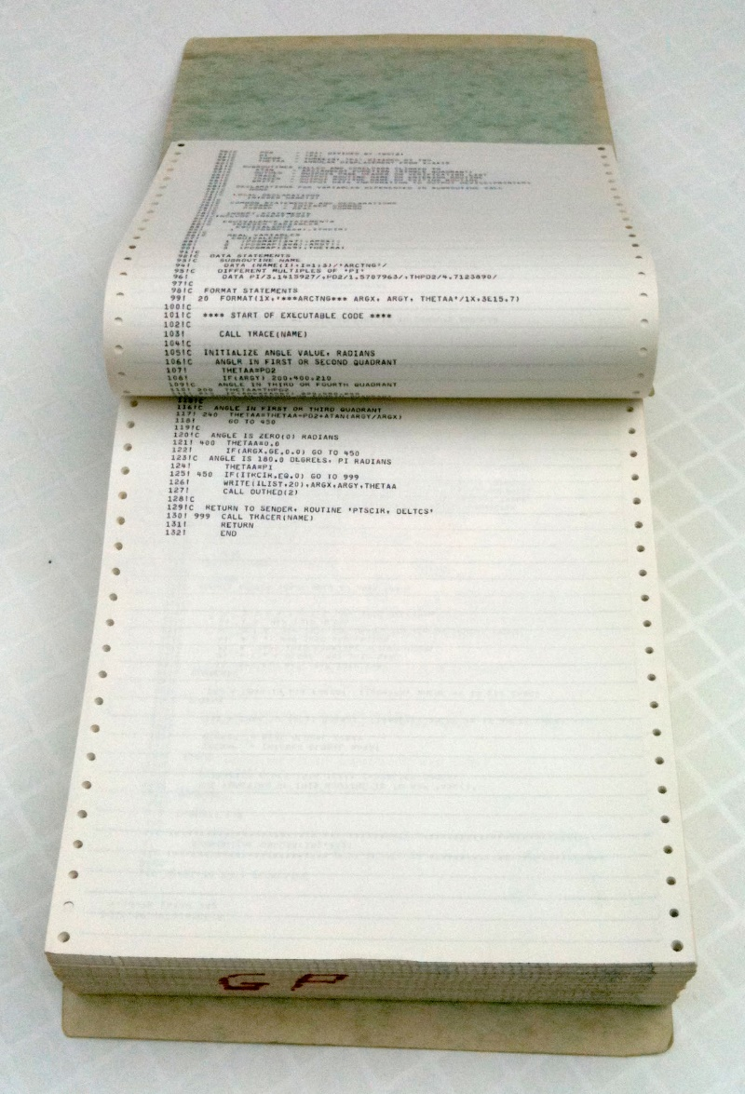
The Old Way (1978)
(Credit: A Reinhold, Wikipedia)

Slide 218
Before
subroutine biogeoclimate
include "common.txt"
real tx(365),tn(365),ta(365),p(365)
real t1(12),t2(12),p1(12)
real littc1,littc2,littn1,littn2
real prcp_n
data prcp_n/0.00002/
c prcp_n: Nitrogen content for unit rianfall (tN/ha)
c
rain_1=0.0
rain_n=0.0
do i=1,12
tmp1=ynormal(0.0,1.0)
tmp1=max(-1.0,min(tmp1,1.0))
t1(i)=tmin(i)+tmp1*tminv(i)
t2(i)=tmax(i)+tmp1*tmaxv(i)
tmp2=ynormal(0.0,1.0)
tmp2=max(-0.5,min(tmp2,0.5))
c forest cover can increase rainfall by maximum 15%
p1(i)=max(prec(i)+tmp2*precv(i),0.0)
c *(1.0+lai*0.02)
rain_1=rain_1+p1(i)
c write(*,*) tmp1, tmp2, tmin(i),tmax(i),prec(i)
rain_n=rain_n+p1(i)*prcp_n
end do
call cov365(t1,tn)
call cov365(t2,tx)
call cov365a(p1,p)
do i=1,365
ta(i)=0.5*(tn(i)+tx(i))
end do
c
c Daily cycles of C, N, H2O
c
rrr=0.0
ypet=0.0
yaet=0.0
avail_n=0.0
degd=0.0
growdays=0.0
drydays=0.0
drydays1=0.0
flooddays=0.0
c
aoc0=aoc0+go_ao_c
aon0=aon0+go_ao_n

Slide 219
After
module Model
use Parameters
use Constants
use Soil
use Site
use Species
use Tree
use Random
use Climate
use Input
implicit none
real, parameter :: grow_min=0.05
real, parameter :: growth_thresh=0.05
real :: growth_min=0.01
contains
subroutine BioGeoClimate(site,year)
integer, intent(in) :: year
type(SiteData), intent(inout) :: site
integer :: gcm_year
integer :: num_species
real, dimension(NTEMPS) :: tmin, tmax, prcp
real, dimension(NTEMPS) :: tmptmin, tmptmax, tmpprec
real, dimension(days_per_year) :: daytemp, daytemp_min, daytemp_max
real, dimension(days_per_year) :: daynums, dayprecip
real :: litter_c_lev1,litter_c_lev2
real :: litter_n_lev1,litter_n_lev2
real :: rain,rain_n,freeze
real :: temp_f,prcp_f
real :: total_rsp,avail_n,n_avail,C_resp,pet,aet
real :: growdays,drydays_upper,drydays_base
real :: flooddays,degday
real :: outwater

Slide 220
After (Continued)
real :: exrad,daylength,exradmx
real :: pot_ev_day
real :: act_ev_day
real :: laiw0_ScaledByMax,laiw0_ScaledByMin
real :: aow0_ScaledByMax,aow0_ScaledByMin
real :: sbw0_ScaledByMax,sbw0_ScaledByMin
real :: saw0_ScaledByFC,saw0_ScaledByWP
real :: yxd3 !used but never set
! used to temporarily hold accumulated climate variables
real :: tmpstep1,tmpstep2
real :: tmp
integer :: i,j,k,m
real, parameter :: min_grow_temp =5.0
real, parameter :: max_dry_parm =1.0001
real, parameter :: min_flood_parm=0.9999
save
num_species=size(site%species)
rain =0.0
rain_n=0.0
! The user is expected to input decr_by values as positive.
if ( linear_cc ) then
if (year .ge. begin_change_year .AND. year .le. &
(begin_change_year + duration_of_change)) then
accumulated_tmin = accumulated_tmin + tmin_change
accumulated_tmax = accumulated_tmax + tmax_change
do m=1,12
tmpstep1 = site%precip(m) + accumulated_precip(m)
tmpstep2 = tmpstep1 * precip_change
accumulated_precip(m) = accumulated_precip(m) + tmpstep2
end do
endif
else if ( use_gcm ) then
gcm_year=start_gcm+year-begin_change_year
if ( gcm_year .ge. start_gcm .and. gcm_year .le. end_gcm ) then
call read_gcm_climate(site%site_id,gcm_year,start_gcm,tmin,tmax,prcp)
site%tmin=tmin
site%tmax=tmax
site%precip=prcp*mm_to_cm
endif
endif

Slide 221
Changes
Converted to modules
Eliminated COMMON, passing all variables (this not only controls the interface, but eventually eliminated a bug)
Renamed most variables to something more descriptive
Added lots of whitespace for visual separation
Aligned typographically (better in source than will convert to PowerPoint)

